Slide 1
Types II
CMSC 330: Programming Languages

Slide 2
Aggregate Types
  Strings
  Arrays
  Records
  Tuples
  Lists
  Variants
  Associate Arrays (Maps)
Type Systems

Slide 3
A type is a collection of values and operations on those values.
Types help ensure:
  Memory safety
  Data abstraction
  Correctness guarantees
  Optimization opportunities
The Descriptor: A collection of a variable's attributes (now often handled by VMs)
  Compile-time: Name, Type, Scope
  Run-time: Memory address, current value, dynamic length

Slide 4
Strings
String Design Dimensions
  Is length fixed or dynamic?
  Are strings mutable?
  Are they value types or reference types?
  Is resizing allowed?
Notes:
Static typing motivation
The compiler knows types before execution
Can detect mismatches early
Prevents many invalid bit interpretations at compile time
Dynamic typing motivation
Type information is stored and checked at runtime
Allows flexibility while still preventing misuse
Runtime checks ensure bits are interpreted consistently

Slide 5
String Length Models
Static length (rare today)
  The length is determined at compile-time and fixed for the life of the program
Limited dynamic (C char arrays)
  You set a maximum capacity (the buffer), but the string inside can be any length up to
Fully dynamic (Python, Java, C++ std::string)
  The length is determined at runtime and there is no pre-set maximum capacity
Tradeoff:
Safety vs performance vs flexibility

Slide 6
String Mutability
Immutable strings: Java, Python
Mutable strings: C arrays, some C++ cases
Why immutability:
  Thread safety
  Hashing
  Security

Slide 7
Arrays
An array is:
  Homogeneous
  Indexed
  Typically contiguous in memory
Key design issue:
How much flexibility should arrays have?

Slide 8
Array Design Axes
Instead of memorizing categories, consider 3 axes:
  Axis 1 — When are bounds known?
  Axis 2 — Where is memory allocated?
  Axis 3 — Can size change?

Slide 9
Axis 1: Binding Time of Bounds
Bounds may be:
  Compile-time fixed
  Allocation-time fixed
  Fully dynamic
Earlier binding → more efficiency
Later binding → more flexibility

Slide 10
Axis 2: Storage Location
Arrays may live in:
  Static memory
  Stack
  Heap
Heap allocation:
  Flexible
  More expensive

Slide 11
Axis 3: Resizability
Fixed-size arrays:
  C, Java arrays
Resizable arrays:
  Python list
  Java ArrayList
Tradeoff:
  Simplicity vs flexibility

Slide 12
Rectangular vs Jagged Arrays
Rectangular:
  True multidimensional
  Contiguous
  Efficient
Jagged:
  Array of arrays
  More flexible
  Possibly fragmented

Slide 13
Row-Major vs Column-Major
Row-major arrays: C, C++, Java
Column-major arrays: Fortran
Affects: memory layout, performance
E.g., [1 2 3, 4 5 6​]
Row-major memory layout:
→ 1, 2, 3, 4, 5, 6
Column-major memory layout:
→ 1, 4, 2, 5, 3, 6

Slide 14
Slices
A slice is a view into part of an array
Supported in Python, Ruby, Functional languages
Useful for abstraction (work with parts of data without extra loops) and functional style
Python Example:
  arr = [10, 20, 30, 40, 50]
  sub = arr[1:4] # elements from index 1 to 3
  print(sub) # [20, 30, 40]

Slide 15
Performance Insight
Why arrays are fast:
  Contiguous memory
  Cache locality
    CPUs fetch memory in blocks (cache lines)
    Accessing elements in order leverages the cache, improving performance
  O(1) indexing

Slide 16
Heterogeneous Aggregates - Records
Heterogeneous aggregate of values
Elements are identified by names (fields)
E.g., { name: "Alice", age: 20 }
Each field can have a different type

Slide 17
Tuples
Tuples:
  Positional
  Unnamed fields
  Often immutable
Used heavily in:
  Functional languages
  Python

Slide 18
Lists
Functional lists:
  Linked cons cells
  head + tail
Advantages:
  Cheap prepend
  Structural recursion
Disadvantages:
  Poor cache locality
    Each element points to the next, which may be scattered in memory
    Accessing elements can cause more cache misses, slowing performance

Slide 19
Associative Arrays (Maps)
Map = A collection of (key → value) pairs
Examples:
  Python dict
  Java HashMap
  JavaScript objects
Modern programming relies heavily on maps.

Slide 20
Algebraic Data Types
Product types combine fields:
  Records
  Tuples
  Called "product" because values combine multiplicatively
Sum types allow one of several variants:
  OCaml variants
  Rust enums
  TypeScript unions
  Only one alternative active at a time

Slide 21
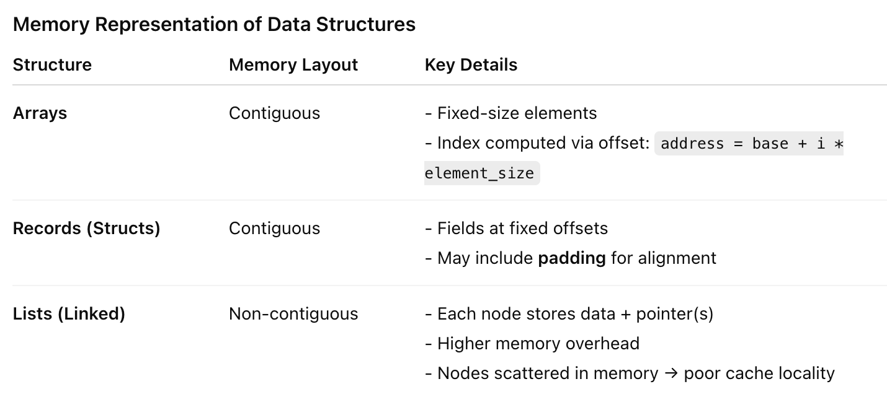
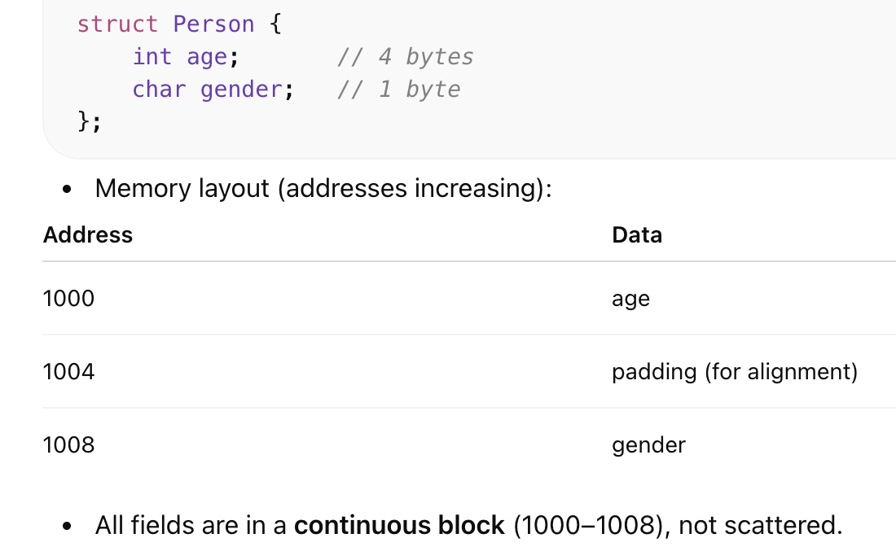
Memory Representation
Notes:
Offset = distance (in bytes) from the start of the record to a field
The compiler knows:
age is at offset 0
gender is at offset 8

Slide 22
Performance Comparison
Arrays:
  Fast access
  Good cache
Lists:
  Flexible
  Slower access
Modern systems often favor arrays.

Slide 23
Type Systems
Type checking ensures:
  Operators applied to compatible operands
  Illegal programs rejected
Static:
  Checked at compile time
  Java, C++, OCaml
Dynamic:
  Checked at runtime
  Python, Ruby

Slide 24
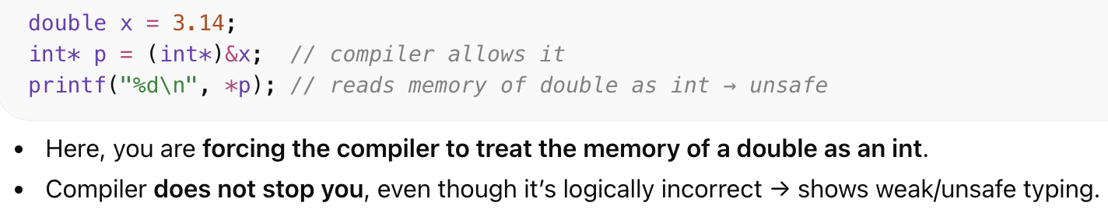
Strong vs Weak Typing
Strong typing:
  Type errors always detected
C and C++:
  Not strongly typed (variadic functions, unsafe casts)
OCaml, Rust: Strongly typed

Slide 25
Type Soundness
A language is sound if: well-typed programs do not go wrong.
“Do not go wrong” means the program cannot perform illegal operations like:
  Accessing invalid memory
  Using a value of the wrong type
  Violating runtime safety rules
This connects to:
  Memory safety
  Runtime guarantees

Slide 26
Modern Type Safety
Modern languages enforce:
  No unchecked pointer arithmetic
  No data races (Rust)
  No null pointer dereference (optional types)
Types prevent whole classes of bugs.

Slide 27
Parametric Polymorphism
Generics:
  Java List<T>
  C++ templates
  OCaml 'a list
One algorithm works for many types.

Slide 28
Why Generics Matter
Without generics:
  Casts
  Unsafe containers
With generics:
  Compile-time guarantees
  Cleaner APIs

Slide 29
Type Inference
Inference means:
Compiler deduces types automatically.
Used in:
  OCaml
  Rust
  TypeScript
Inference ≠ dynamic typing.

Slide 30
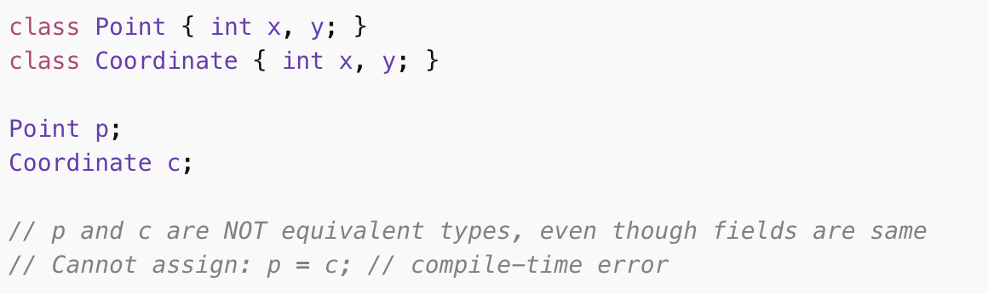
Name Type Equivalence
Two types are equivalent if:
They have the same declared name.
Used in:
  Java
  C#

Slide 31
Structural Type Equivalence
Types equivalent if:
Their structure matches.
Used in:
  Go
  TypeScript (partially)

Slide 32
Tradeoffs in Type Equivalence
Nominal typing:
  Strong abstraction boundaries, enforce clear separation of types
Structural typing:
  More flexible, types compatible if structures match
Affects API design and safety.
  API Design: Nominal typing encourages strict contracts, structural typing allows generic, flexible interfaces
  Safety: Nominal typing provides stronger compile-time guarantees, structural typing trades some safety for convenience

Slide 33
Design Tradeoffs Recap
Aggregate types vary along:
  Memory layout
  Binding time
  Flexibility
  Safety

Slide 34
Modern Themes
Modern PL trends:
  Strong static typing
  Algebraic data types
  Pattern matching
  Type inference
  Generics
  Safety-first design

Slide 35
Type systems are:
  Not just classification tools
  Mechanisms for enforcing invariants
  Foundations for safe and reliable systems
Research and Discuss
  Why did Rust redesign unions as safe enums?
  Why do dynamic languages dominate scripting?
  Should structural typing replace nominal typing?

